Slide 1

FOODIE

Slide 2

About Us
What Is Foodie ?
Food Delivery App
Foodie is a dynamic and innovative startup food delivery company aiming to change the way people eat. We launched in 2023 and are eying to become a go-to site for foodies searching for various gastronomic treats delivered to their location of choice. Our objective is to create joy via food, to support local businesses, and to offer our delivery partners flexible income options.
Foodie is an online delivery food business that delivers food to consumers on demand from stores and restaurants.

Slide 3



Team
Foodie Team
Hasanul Banna
Jacqueline Dela Rosa
Guangye Li
CEO
coo
cio

Slide 4




Team
Foodie Team
Yuchen Yang
Shweta Hooda
Deepanshu Chandna
Md. Shimul Hossain
CTO
CSO
CFO
CGO

Slide 5
Company Structure
Our company structure is designed to comply with ISO 27001 standards, ensuring data security at each operational level. We have an Information Security Management System (ISMS) in place that spans all departments, from customer service to delivery logistics. This integrated approach helps us maintain the confidentiality, integrity, and availability of our data

Slide 6
Mission
To provide convenient and reliable food delivery services that connect customers with their favourite restaurants and food establishments, ensuring timely and delicious meals are delivered right to their doorstep. We aim to enhance the overall dining experience, saving customers time and effort while supporting local businesses in the process.
Vision
Our vision is to become the leading and most trusted food delivery platform, revolutionizing the way people access and enjoy their favourite meals. We aspire to create seamless and enjoyable dining experiences for customers while empowering restaurants to expand their reach and grow their businesses.

Slide 7
About Us
Why ISMS is being implemented
Implementing an ISMS in a food delivery company like ours is crucial for securing sensitive data, such as customer information and payment details. ISMS helps us manage risks and ensures compliance with legal and contractual requirements. In an industry where trust is
Delivery
Food & Drink
Mobile Apps

Slide 8


Foodie’s applicable laws and regulations
Certainly, there are business rules and regulations. To operate this business in New South Wales, Australia, these specific restrictions and regulations must be met. To maintain full compliance, we interact with regulatory authorities, obtain legal advice, and stay informed of any updates or changes to the rules and regulations that may affect our company.

Slide 9
Foodie’s ISMS
Implementation Plan

Slide 10
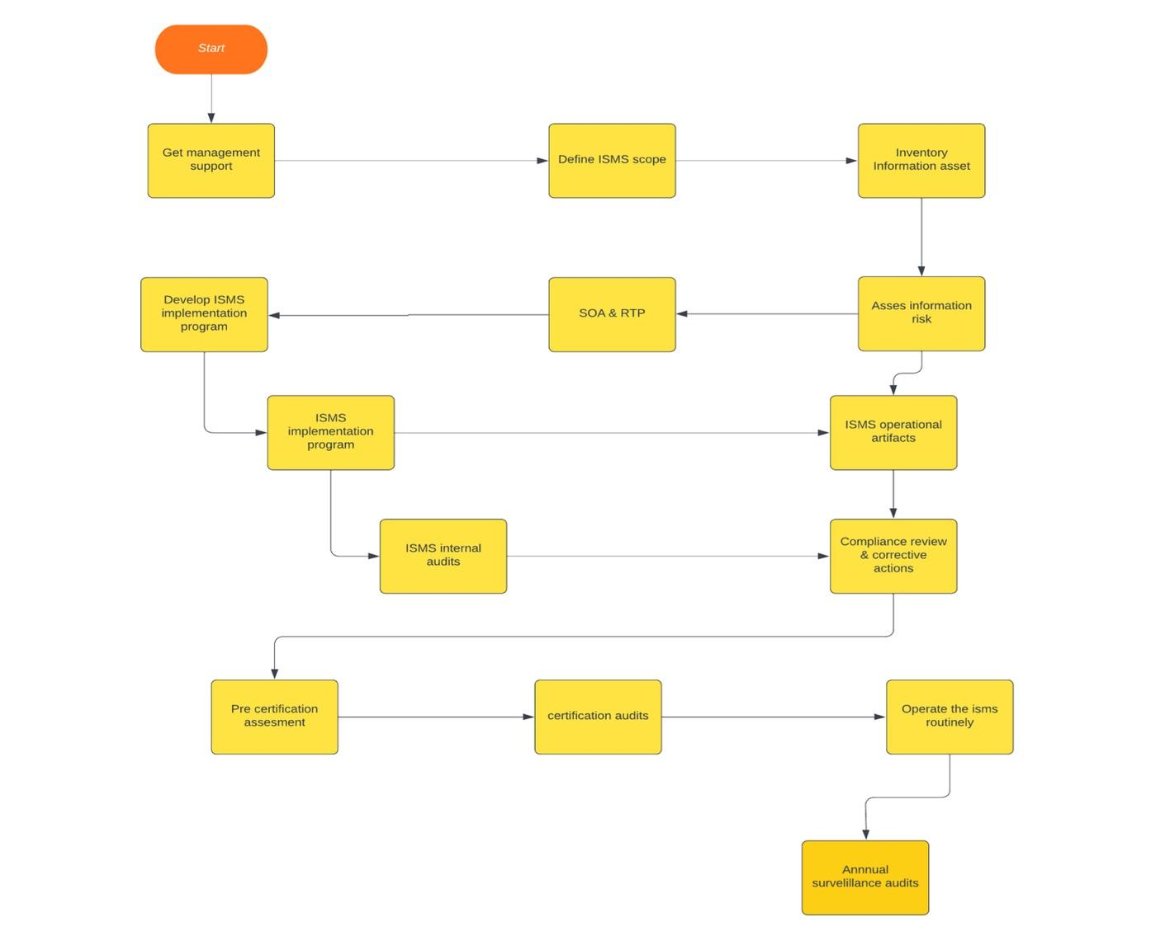
ISO 27001 Implementation Plan

Slide 11

Foodie
README Document
In Foodie’s ISMS documentation, there are two Excel documents and thirteen Word documents in total.
This README document is designed to assist employees, auditors, and stakeholders in easily navigating our ISMS documentation. It provides a directory of all ISMS documents and brief descriptions and links to access each document.
INSTALL APPS

Slide 12
Foodie’s ISMS
Process Map Operation

Slide 13
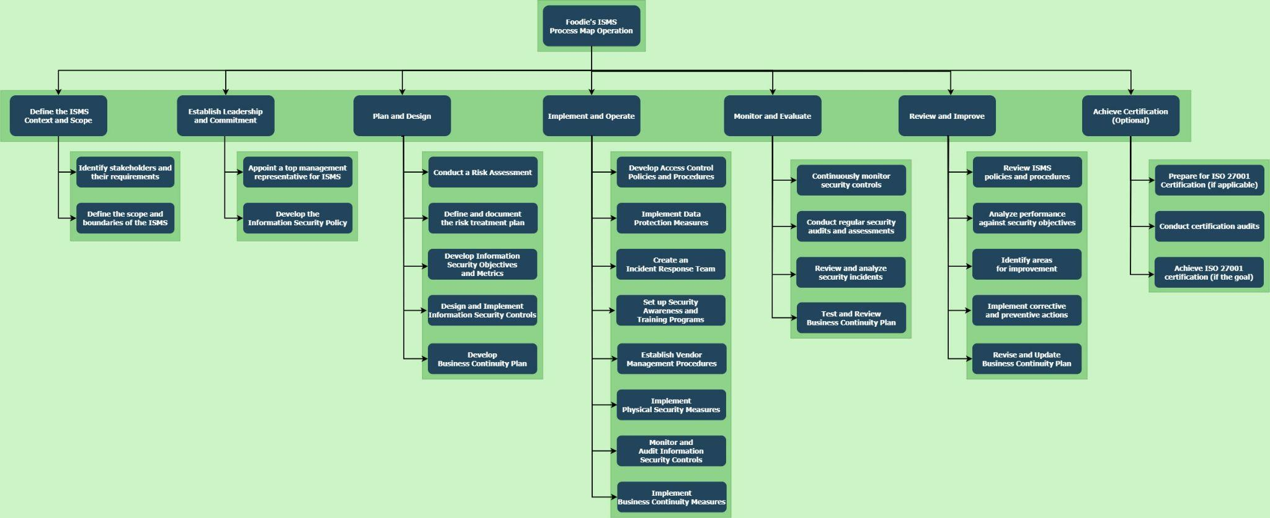

Slide 14
Define the ISMS Context and Scope
I
Identify stakeholders and their requirements
The Company Information & Business Model document provides an introductory overview of Foodie, including its background, business model, information security standards, technical objectives, and regulatory compliance. This information is essential for integrating relevant details into Foodie's Information Security Management System (ISMS).
Define the scope and boundaries of the ISMS
D
The ISMS scope for Foodie's operations is defined to encompass critical components like order processing systems, customer databases, payment gateways, and other relevant systems and data, ensuring their comprehensive protection. The Security Assessment Documentation sets information security objectives, monitoring plans, and security control policies, serving as a framework for assessing and maintaining security within the defined ISMS scope.

Slide 15
Establish Leadership and Commitment
A
Appoint a top management representative for ISMS
In an ISMS, a senior executive (CIO or CSO) is crucial as the top management representative, responsible for leadership, resource allocation, and ISMS integration into the company's strategy. The document "Evidence of the competence of the people working in information security" details personnel competence, background, and roles at Foodie.
Develop the Information Security Policy
D
Develop a tailored Information Security Policy for the food delivery hub, emphasizing the commitment to protect customer data, secure transactions, and ensure service availability. This policy will serve as the cornerstone for all security-related actions.

Slide 16
Plan and Design
C
Conduct a Risk Assessment
Identify and assess risks linked to food delivery operations, including data breaches, service disruptions, cyber-attacks, and regulatory compliance issues. This risk assessment forms the foundation for implementing suitable security measures.
Define and document the risk treatment plan
D
Create a risk treatment plan with control measures, contingencies, and incident response procedures to minimize vulnerabilities.
D
Develop Information Security Objectives and Metrics
Set clear security objectives in alignment with Foodie's organizational goals. Define measurable metrics to gauge the efficiency of security controls. Security Assessment Documentation sets information security objectives.
Design and Implement Information Security Controls
D
Implement tailored security controls for the Foodie organization, including encryption, access management, secure coding, and network security to protect sensitive data and critical systems.
D
Develop Business Continuity Plan
Create a BCP for Foodie outlining procedures for maintaining essential services during disruptions like natural disasters or cyber incidents, including data recovery, service restoration, and stakeholder communication.

Slide 17
Implement and Operate
D
Develop Access Control Policies and Procedures
Establish access control policies for user privileges, authentication, and authorization. Implement role-based access management to secure sensitive systems for authorized personnel.
Implement Data Protection Measures
I
Use encryption, tokenization, and anonymization to safeguard customer data during storage and transmission, preventing unauthorized access and data breaches.
C
Create an Incident Response Team
Create an Incident Response Team (IRT) to detect, analyze, and respond to security incidents. Define roles, responsibilities, communication, and escalation procedures for a rapid and effective response to breaches.
Set up Security Awareness and Training Programs
S
Create security awareness programs and training materials for employees, contractors, and partners to educate them about security threats, best practices, and organizational policies. Regular training fosters a security-conscious culture.
E
Establish Vendor Management Procedures
Establish procedures to assess, select, and monitor third-party vendors. Vendor management ensures they meet security standards and contractual obligations, reducing supply chain risks.
Implement Physical Security Measures
I
Implement physical security for data centers and critical facilities, including surveillance, access controls, biometrics, and environmental protection to prevent unauthorized access and physical threats.
M
Monitor and Audit Information Security Controls
Regularly monitor security controls through audits and assessments to identify vulnerabilities, compliance gaps, and emerging threats. This ongoing process ensures the integrity of security measures.
Implement Business Continuity Measures
I
Implement the strategies and measures from the Business Continuity Plan (BCP) for the food delivery hub to maintain critical services and data availability during disruptions. Regular testing and exercises confirm the BCP's effectiveness.

Slide 18
Monitor and Evaluate
C
Continuously monitor security controls
Implement continuous monitoring systems that provide real-time visibility into the performance of security controls. Continuous monitoring ensures the timely detection of security incidents and anomalies.
Conduct regular security audits and assessments
C
Regularly perform comprehensive security audits and assessments to evaluate the overall security posture. These evaluations identify areas for improvement and help maintain compliance with industry standards.
R
Review and analyze security incidents
Review all security incidents that occur in Foodie's organization. Conduct in-depth analysis and root cause assessments to identify lessons learned and improve incident response procedures.
Test and Review Business Continuity Plan
T
Periodically test the effectiveness of the Business Continuity Plan (BCP). Conduct exercises and simulations to evaluate the plan's readiness to address different types of disruptions. Review and update the BCP based on the results of tests.

Slide 19
Review and Improve
R
Review ISMS policies and procedures
Conduct regular reviews of ISMS policies and procedures to ensure they remain aligned with the evolving threat landscape and organizational changes. Updates should reflect lessons learned from incidents and changing industry regulations.
Analyze performance against security objectives
A
Assess the organization's performance against defined security objectives and metrics. Analyze the results to identify areas for improvement and align security measures with the organization's strategic goals.
I
Identify areas for improvement
Based on performance analysis and incident reviews, identify areas where security can be enhanced. These areas may include process improvements, control enhancements, and employee training
Implement corrective and preventive actions
I
Develop and implement action plans to correct security deficiencies and prevent the recurrence of incidents. Corrective actions address existing security issues, while preventive actions aim to avoid future problems.
R
Revise and Update Business Continuity Plan
Regularly review, revise, and update the (BCP) to address changing risks, business processes, and lessons learned from tests and real incidents. The BCP should evolve to ensure the continued resilience of the organization.

Slide 20
Achieve Certification (Optional)
P
Prepare for ISO 27001 Certification (if applicable)
If ISO 27001 certification is a goal, prepare the organization by aligning ISMS practices with ISO 27001 requirements. This involves conducting a gap analysis, addressing identified gaps, and preparing the organization for certification audits.
Conduct certification audits
C
Engage with a certification body to conduct audits to assess the organization's compliance with ISO 27001 standards. These audits evaluate the effectiveness of ISMS practices.
A
Achieve ISO 27001 certification (if the goal)
After successfully completing certification audits, the organization achieves ISO 27001 certification, demonstrating its commitment to information security and compliance with international standards.

Slide 21
Foodie’s ISMS
Foodie’s ISMS
How ISMS relates
Foodie’s ISMS
How the ISMS relates to the
organizations governance framework

Slide 22
"Leveraging ISMS 27001 to Strengthen FOODIE's Governance
Framework."

Slide 23
Governance Assets:
Regularity Guidelines: Setting the benchmark for operational compliance.
Employee Code of Conduct: Ensuring ethical behavior and data protection.
Vendor Contracts: Establishing clear expectations and responsibilities with suppliers.

Slide 24
Key Risk Scenarios :
Supply Chain Interruption: Supplier failing to meet contractual obligations.
Data Breach: Unauthorized data sharing by vendors.
Reputation Hazards: Association with ethically or environmentally unsound suppliers.

Slide 25
How ISMS27001 Addresses the Risks :
Supply Chain Interruption: ISMS provides robust vendor assessment criteria incorporated in our Vendor Contracts.
Data Breach: ISMS emphasizes data protection, reinforced through our Employee Code of Conduct and Vendor Contracts.
Reputation Hazards: ISMS27001's due diligence processes, coupled with our Regularity Guidelines, ensure ethical partnerships.
Through the synergy of ISMS 27001 and our governance assets, FOODIE ensures secure, ethical, and efficient operations

Slide 26
Foodie’s ISMS
Risk Management Process

Slide 27
Risk Management
Foodie's risk management process utilize risk assessment and treatment, to ensure that the potential risks in our operations are effectively identified, analyzed, and mitigated. It covers all Foodie operations, from supply chain management to data handling and service delivery.

Slide 28
About Us
Our Risk Management strategy
A clear establishment of our operational context and alignment with our strategic goals
Identify potential risks, evaluate for their likelihood and impact, and then estimate in terms of their potential damage.
Develop appropriate risk treatment plan.
Integrate the Deming Cycle's principles of "Plan-Do-Check-Act" for continuous improvement.

Slide 29
Foodie’s
Risk Management Process Cycle
Context Establishment
Integrating Deming Cycle: Act on Monitoring and Review
Risk Assessment
Integrating Deming Cycle: Check
Risk Treatment
Plans for new Information Assets Management Procedure

Slide 30

Foodie
Context Establishment
First step of the Risk Management process cycle
Foodie's risk management starts by understanding the purpose and aligning with strategic objectives. We set clear boundaries and define our scope to ensure every risk, big or small, within our operations gets due consideration. By setting a clear operational baseline, Foodie is better equipped to identify deviations or threats, allocate resources efficiently, and communicate risk-related matters with clarity and relevance across the organization.
INSTALL APPS

Slide 31
Context Establishment
Risk Management Scope
Foodie's risk management scope encompasses its entire operations, from routine tasks like order handling and delivery to strategic initiatives. Specifically, it will manage the potential threats of Foodie’s critical information assets identified from critical business activities.

Slide 32
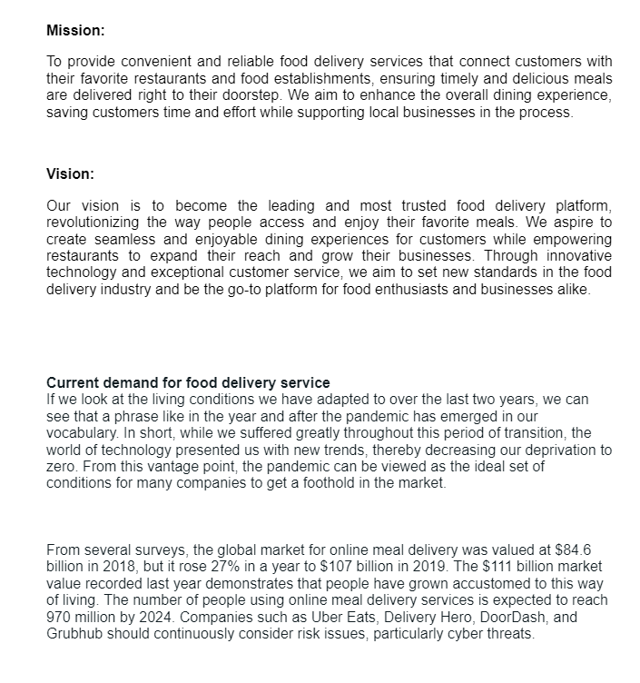
Context Establishment
Foodie’s strategic goals and internal context
Foodie’s strategic goals and its internal context is identified in the document
“Company Information & Business model”.

Slide 33
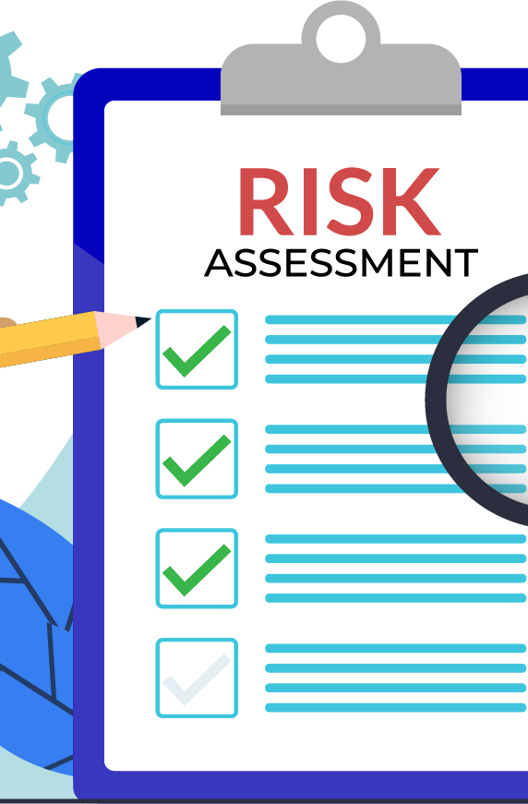
Foodie
Risk Assessment
Second step of the Risk Management process cycle
The purpose of conducting risk assessments as part of our risk management strategy is to systematically identify and evaluate potential threats that could hinder our objectives. Through thorough risk assessments, we gain crucial insights into the vulnerabilities within our operations, allowing us to anticipate, prepare for, and respond to various scenarios. It empowers us to make informed decisions, prioritize resources, and continuously refine our strategies for better outcomes.
INSTALL APPS

Slide 34
Risk Identification
Risk Estimation
Risk Evaluation
V
Risk Assessment
Three main processes

Slide 35
Risk Assessment
Risk Identification
To properly detect and document the risks that could potentially have a negative impact on Foodie. The following actions have been implemented.
Identification of major information assets
Identification of the risk scenarios of the major information assets
Assignment of information assets’ owner
Identification of information assets’ classification and labelling

Slide 36
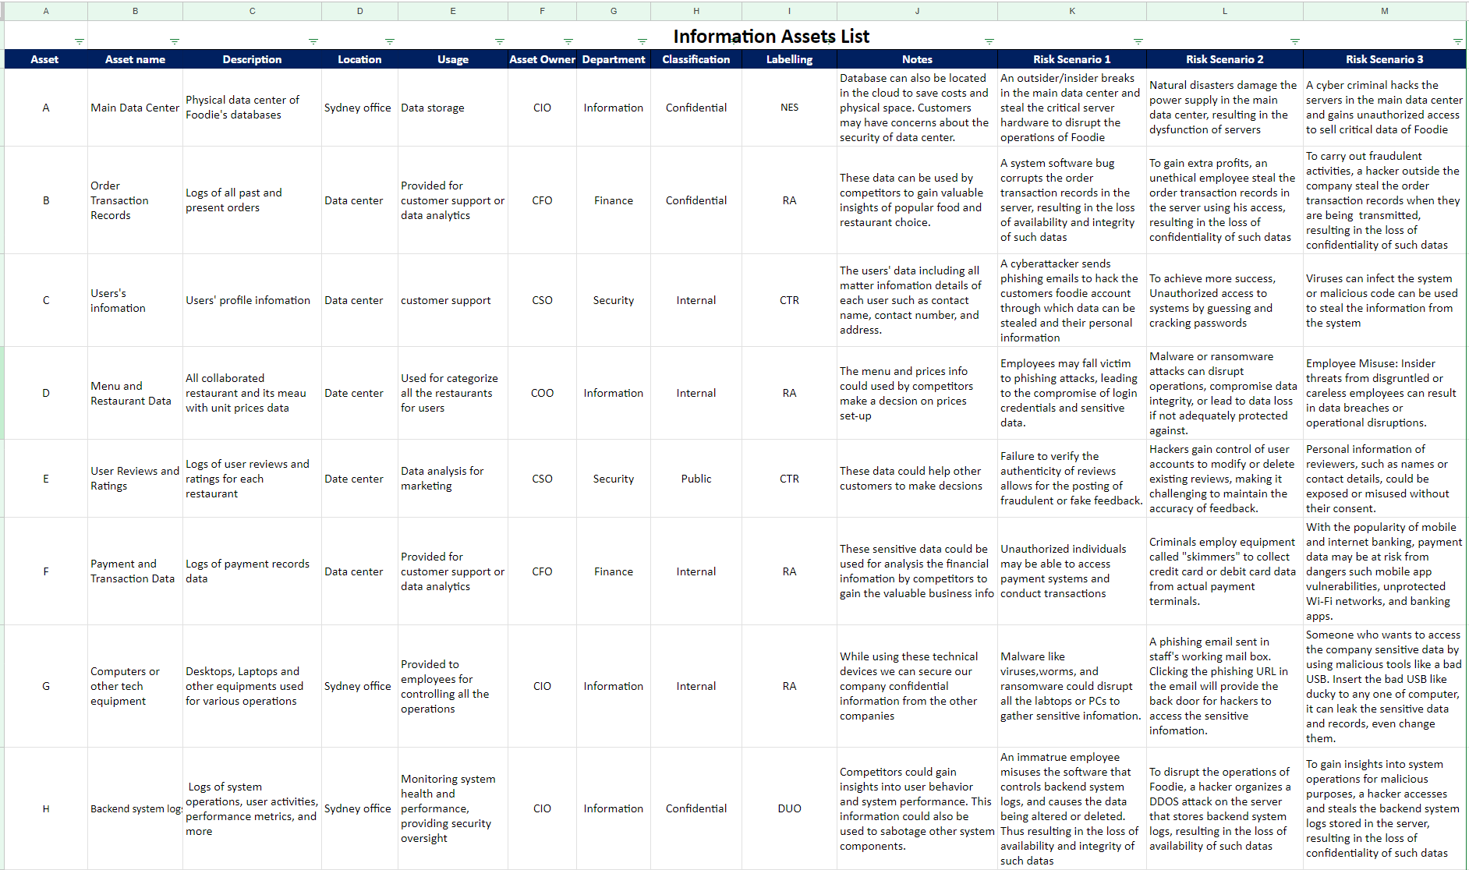

Slide 37
Risk Assessment
Risk Estimation
To assess potential threats and vulnerabilities of the valuable information assets of Foodie accurately and systematically, the following processes have been implemented.
Risk scenarios analysis (TRA): To systematically identify and evaluate Foodie’s critical information assets’ potential threats and associated vulnerabilities that could negatively impact the Foodie's operations and business objectives.
WWMD Table: The WWMD table provides a structured approach for management's response to various risk scenarios. It offers a roadmap on the actions to be taken based on the magnitude or severity of a particular risk.
Consequence Table: The consequence table categorizes risks based on their potential impact. It helps in understanding the severity of a risk event and thus guides Foodie’s risk treatment decisions.
Business Impact Analysis: Business Impact Analysis is to systematically evaluate and quantify the potential effects of interruptions or disruptions to Foodie’s food delivery service.

Slide 38
Risk Assessment
TRA
To systematically identify and evaluate Foodie’s critical information assets’ potential threats and associated vulnerabilities that could negatively impact the Foodie's operations and business objectives.
Vulnerabilities.
Threats.
Controls.
Loss Calculations.

Slide 39
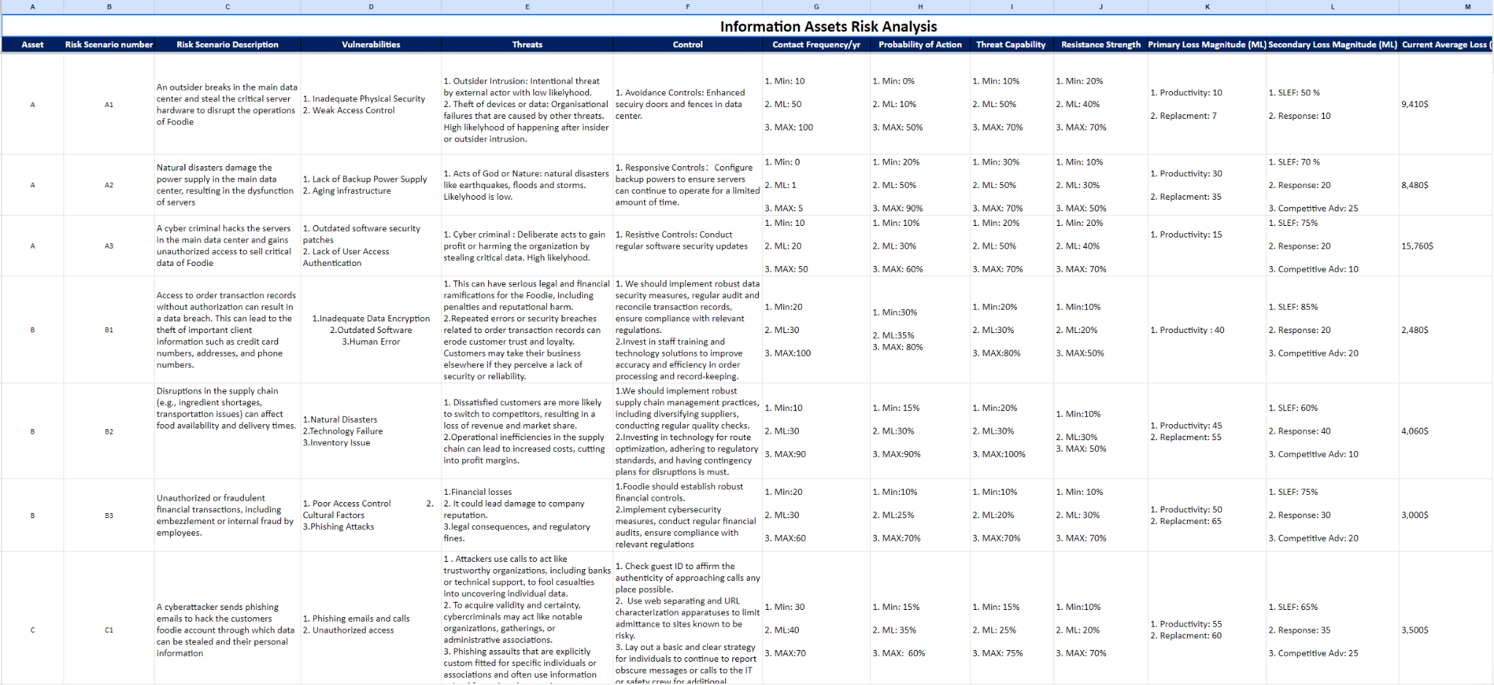

Slide 40
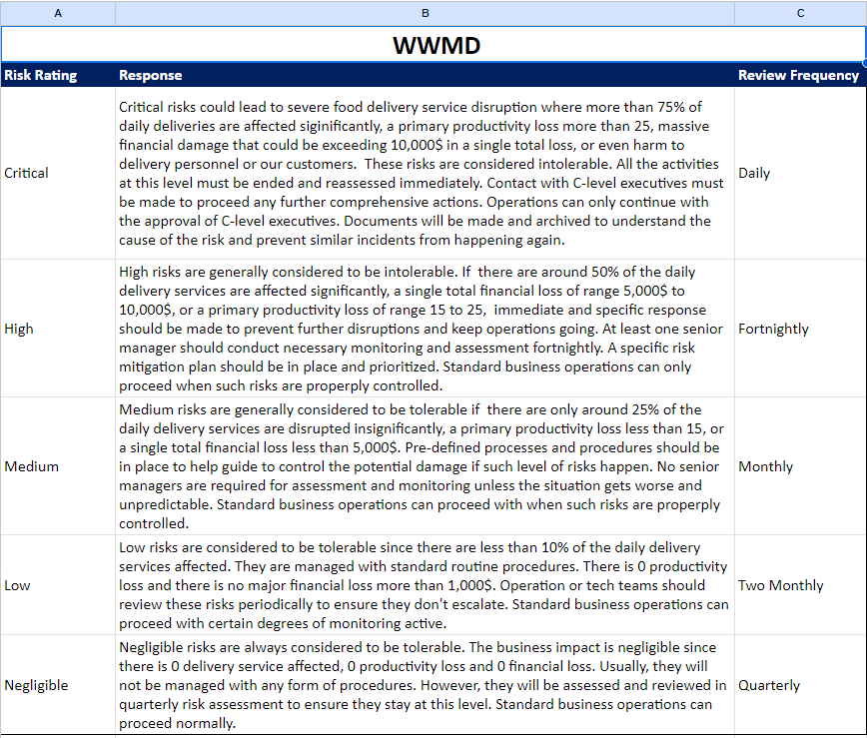
Risk Assessment
WWMD Table
The WWMD table provides a structured approach for management's response to
various risk scenarios. It offers a roadmap on the actions to be taken based on the
magnitude or severity of a particular risk.
Risk ratings.
Response.
Review Freqeuncy.

Slide 41
Risk Assessment
Consequence Table
The consequence table categorizes risks based on their potential impact. It helps in understanding the severity of a risk event and thus guides Foodie’s risk treatment decisions.
Impacted Business Areas.
Response.
Review Frequency.

Slide 42
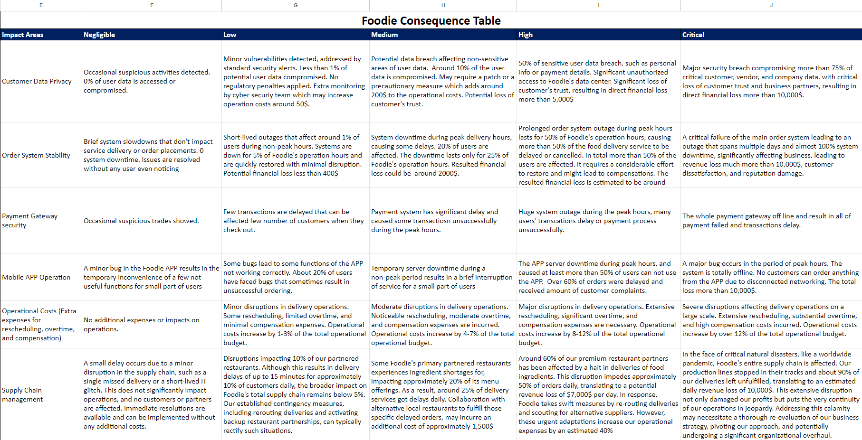

Slide 43
Risk Assessment
BIA analysis
Business Impact Analysis is to systematically evaluate and quantify the potential effects of interruptions or disruptions to Foodie’s food delivery service.
Single Total loss: The estimated potential financial on a scale of 1 hour, 1 day and 1 week.
Time or Resources: The critical resources or time required to maintain and restore business operations on a scale of 1 hour, 1 day and 1 week.
Political: The negative impacts or consequences Foodie might experience in its political environment on a scale of 1 hour, 1 day and 1 week.

Slide 44
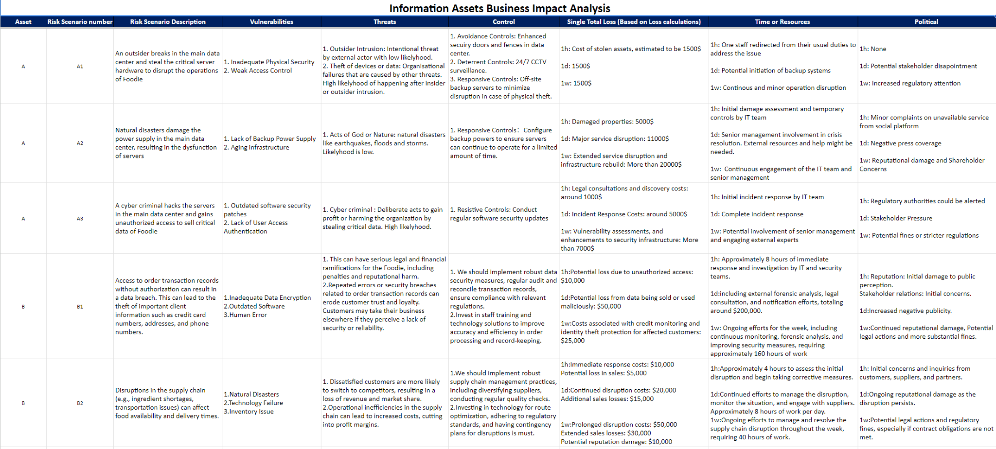

Slide 45
Risk Assessment
Risk Evaluation
To properly determine the significance of the identified risks and prioritize them, the following processes have been implemented.
Identification of risk tolerance/risk appetite in WWMD table
Evaluation of business continuity

Slide 46
Risk Assessment
Risk Appetite
To properly define risk appetite in Foodie’s risk management process,
Foodie’s strategic business goal and its core business activities needs
to be considered.

Slide 47
Risk Assessment
Evaluation of business continuity
The purpose of evaluating business continuity and creating a business continuity plan (BCP) is to ensure the ability of Foodie to maintain or quickly resume its critical functions in the face of adverse events or disruptions. In the document “Foodie- Business Continuity Plan”, we linked the business continuity assessment back to the BIA in the risk estimation process.
Critical Business Activities Identification
Business Continuity Risk Assessment
Business Continuity Plan Development
Regular Review and Ongoing Maintenance

Slide 48
Risk Assessment
Critical Business Activities Identification
The identification of critical business activities serves as a foundational step in ensuring the resilience, continuity, and sustainability of Foodie’s business operations.
What should be considered as Foodie’s critical activities?
Considering Foodie is a company that provides food delivery service, the constant availability of food delivery services, food safety and health regulations are essential. Any business activity that can affect the continuity of these business areas can be considered as critical business activity.
Identification of critical activities

Slide 49
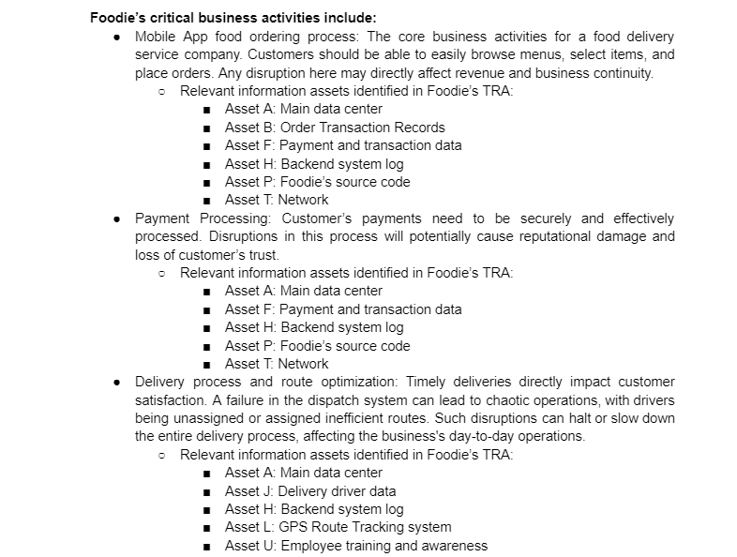

Slide 50
Risk Assessment
Business Continuity Risk Assessment
By summarizing the risk assessment and business impact analysis conducted in Foodie’s TRA table, this section will identify potential threats and vulnerabilities of these critical information assets that could interrupt Foodie's operations, evaluate their potential impact, and establish the foundation upon which our Business Continuity Strategy is built.
What risks would be considered to have a critical impact on business continuity:
According to the WWMD table, intolerable risks that are high or critical level.
Time-sensitive risks require immediate attention.
Residual risks that unacceptable after mitigation.
BIA analysis

Slide 51
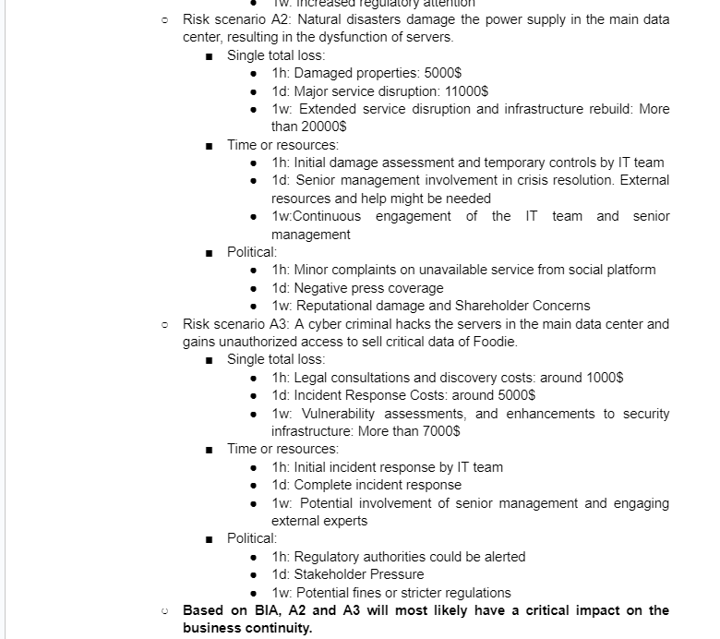
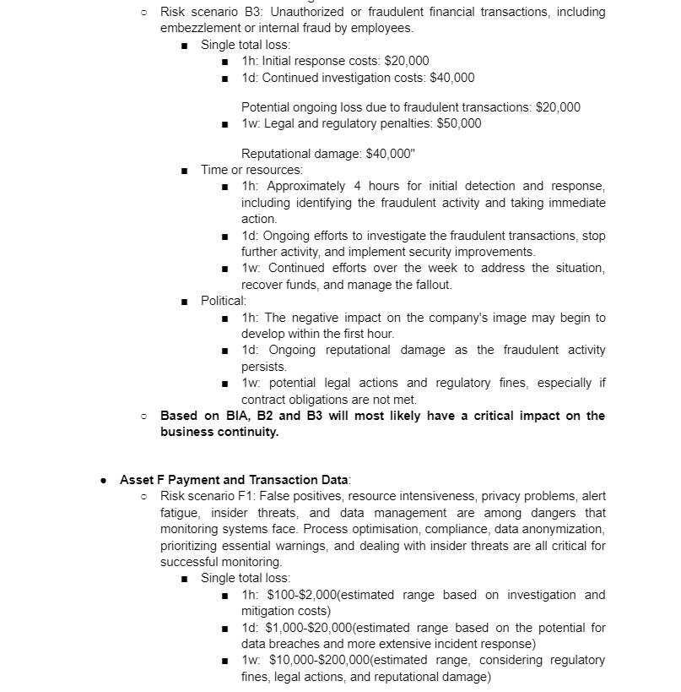

Slide 52
Risk Assessment
Business Continuity Plan Development
To ensure uninterrupted service to our customers and reduce the risk of business disruptions, comprehensive business continuity strategies are tailored to address potential impacts arising from identified critical information assets and its scenarios.
Critical assets and its critical scenarios identified
Key functions
Primary asset owner
Procedures to ensure business continuity.
Immediate procedures.
Short-term procedures.
Long-term procedures.

Slide 53
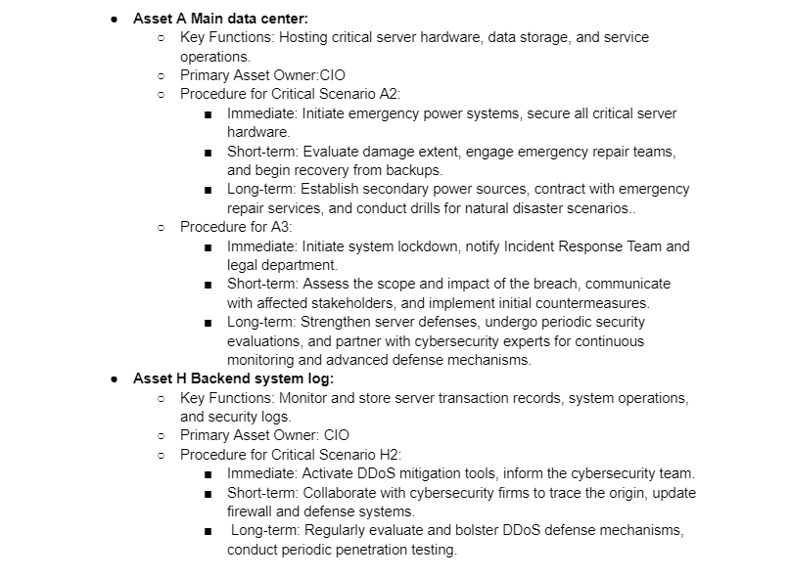

Slide 54
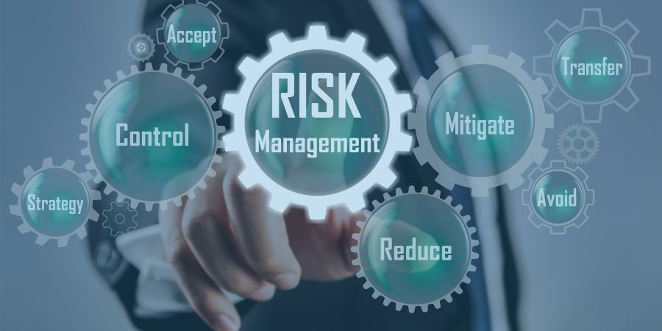
Foodie
Risk Treatment
Third step of the Risk Management process cycle
Foodie’S Information Risk Treatment Plan is a comprehensive strategy for mitigating information security risks within the context of the food industry. It's a crucial component of a broader information security program that helps protect sensitive data and ensure the integrity, confidentiality, and availability of information.
INSTALL APPS

Slide 55
Prioritization of Risks
Cost efficiency analysis
SOA
V
Risk Treatment
Risk Treatment Decision Process
Risk Treatment Options Selection
How the controls are selected
Risk Retention
Risk reduction
Residual risks

Slide 56
Risk Treatment
Risk Treatment Decision Process
Prioritization of Risks: By quantifying potential losses, Foodie can prioritize risks in order of magnitude, ensuring that the most severe threats are addressed first and its controls are selected accordingly.
Use of OpenFair Risk Analytic tool.
Cost efficiency analysis: With clear loss calculations, Foodie can allocate appropriate resources for mitigation strategies and ensure that they are financially prepared for potential risks.
Current Average loss (total risk): It describes the average financial loss per year of a specific risk scenario of one of Foodie’s critical assets.
Single total loss: It describes the potential financial loss of a specific risk scenario of one of Foodie’s critical assets that happens once.
Contact Frequency: the frequency with which a threat event (e.g., a cyber attack) comes into contact with Foodie’s vulnerable asset or system.
Primary Loss Magnitude: Once a threat event occurs, PLM determines the magnitude of loss that results directly from that event. In Foodie’s context, it is a loss of productivity for our delivery service.

Slide 57
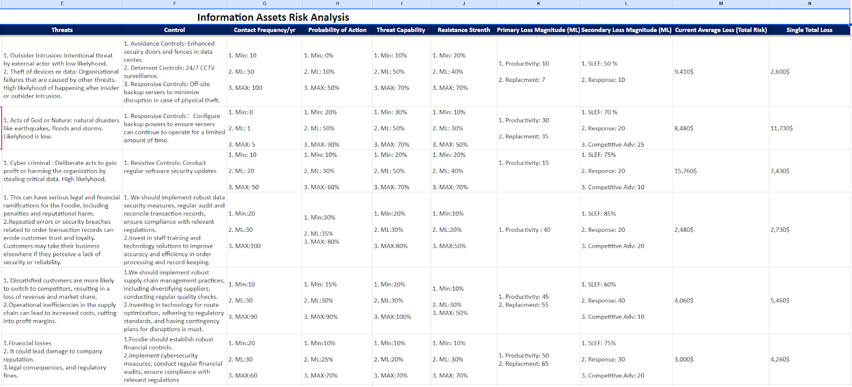

Slide 58
Risk Treatment
Risk Treatment Decision Process
The statement of applicability has also been identified to help Foodie ensure that all potential risk treatments (controls) are considered, justified, and documented. Foodie’s SOA document outlines which of the standard’s controls are applicable to Foodie and explains why those controls have been selected. Full document can be found in “Foodie The Statement of Applicability”
Clarifying Relevant Controls: The SOA provides a comprehensive list of controls and their applicability. Foodie can quickly identify which controls are relevant to which risks, streamlining the treatment decision process.
Gap Analysis: The SOA helps identify areas where current security measures may be lacking, aiding the decision-making process on what additional controls are needed.
Explaining Control Choices: The explanations in the SOA provide a rationale for why certain controls were chosen and others were excluded. This reasoning can guide risk treatment decisions by providing context and clarity.
Continuous Improvement: As risks evolve, Foodie will continuously update the SOA document, ensuring that the risk treatment decision process is always based on current, relevant information.

Slide 59
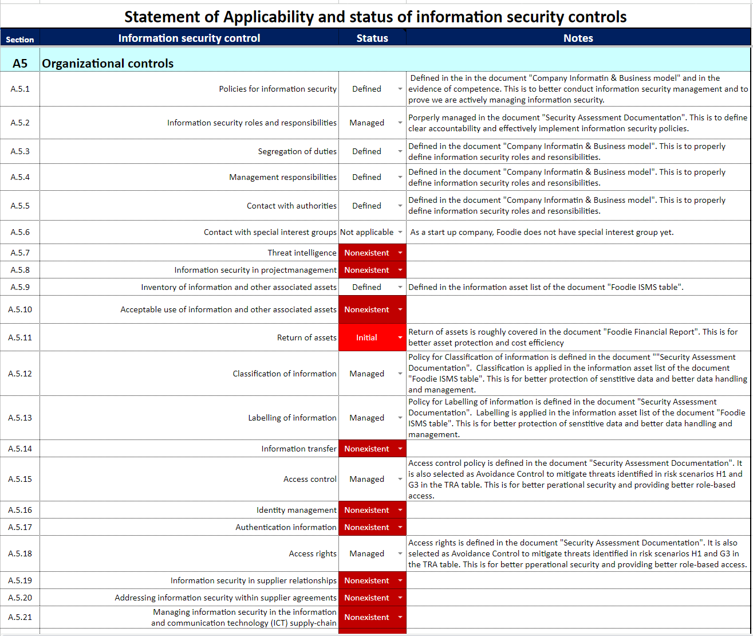

Slide 60
Risk Treatment
Risk Treatment Options Selection
Risk Retention
According to the WWMD table, if the Single Total Loss of one particular risk is less than 5,000$ or the primary loss magnitude (percentage of delivery service affected) is less than 25%, we consider this risk level medium and it is tolerable. Foodie will accept the residual risks.
Risk reduction
If the Single Total Loss of one particular risk is more than 5,000$ or the primary loss magnitude (percentage of delivery service affected) is more than 50%, we consider this risk level is high and it is intolerable. Appropriate controls will be implemented to mitigate such risk.

Slide 61
Risk Treatment
Risk Treatment Options Selection
Given the information found in the loss calculations, a systematic approach that considers various risk parameters is essential. We will mainly use the following four risk parameters when selecting the appropriate controls:
Current Average Loss (Total Risk): This value essentially offers a historical perspective on the financial implications of a specific risk scenario. Controls for risks that historically have a higher average loss would likely be prioritized. In essence, by focusing on controls that address these high average loss scenarios, Foodie can potentially achieve a significant reduction in its overall risk posture.
Single Total Loss: This is about assessing the maximum potential damage of a risk scenario. Even if a particular threat has a low frequency, if its potential damage (or single total loss) is extremely high, it might still warrant significant attention.
Contact Frequency: Controls selected based on contact frequency would primarily focus on the most frequently occurring threats. A high contact frequency indicates a regular or recurring threat, and measures should be in place to either prevent these occurrences or mitigate their effects when they occur.
Primary Loss Magnitude (Productivity Loss for Delivery Service): This metric focuses on the operational impact of a threat event. If a threat leads to a significant loss of productivity, even if its direct financial impact is low, it's crucial to address it. The rationale here is that disruptions to Foodie’s core services (like delivery) could lead to long-term reputational damage, customer attrition, and other indirect costs.

Slide 62
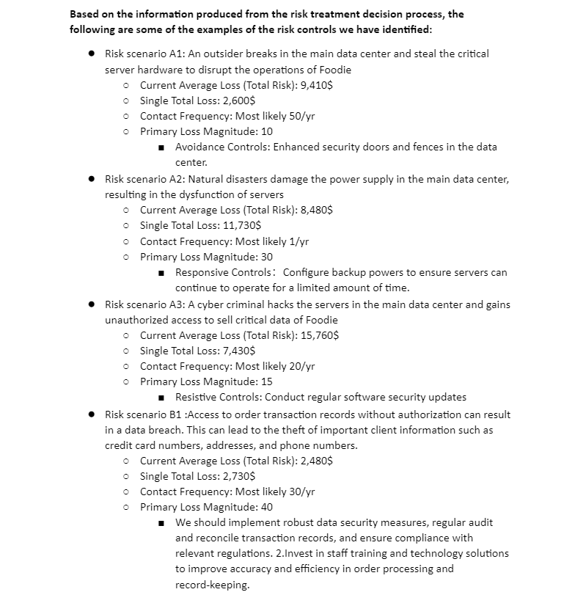

Slide 63
Risk Treatment
Risk Treatment Options Selection
Foodie need to deal with residual risks, especially those deemed unacceptable after the application of controls. We seek to ensure that all activities undertaken by Foodie are within acceptable risk parameters, aligning with our commitment to safeguarding our stakeholders and assets.
Residual risks:
Re-evaluation of Current Controls: All current risk controls shall be regularly reviewed for their efficacy. If they are found wanting, enhancement or fortification measures should be considered. Where necessary, redundant controls will be introduced to ensure risk is managed to acceptable levels.
Risk Avoidance: Activities or processes that consistently yield unacceptable risks, after comprehensive analysis, may be recommended for discontinuation or replacement.
Risk Transfer: Financial tools such as insurance will be considered to mitigate potential financial losses arising from realized risks. Functions that are deemed too risky and better managed externally may be outsourced to specialists.

Slide 64
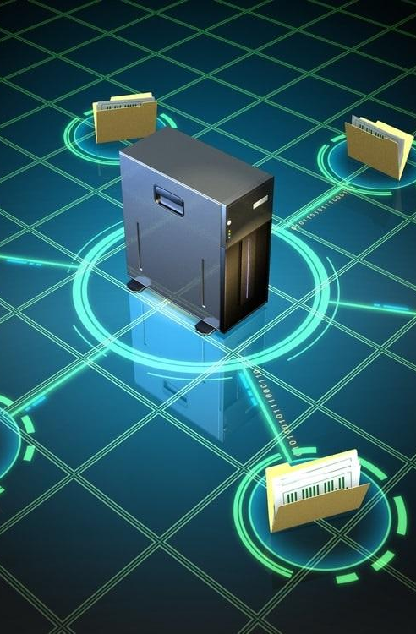
Foodie
Plans for new Information Assets Management Procedure
Fourth step of the Risk Management process cycle
To ensure that new information assets are introduced into our systems and processes safely and in alignment with Foodie's overarching risk management strategy.
INSTALL APPS

Slide 65
Plans for new Information Assets Management Procedure
New Information Assets’ procedure
To ensure that new information assets are introduced into our systems and processes safely and in alignment with Foodie's overarching risk management strategy.
Asset Identification and Categorization: Upon introduction, each new information asset will be identified and categorized based on its criticality, sensitivity, and intended use. If the new assets are critical, they will be added to the information assets list in “Foodie ISMS Tables”. Information classification will help in tailoring specific risk management procedures for each asset.
Risk Assessment: Follow the same procedures identified in the document “Risk Assessment Document”.
Risk Treatment: Follow the same procedures identified in the document “Foodie Information Risk Treatment Plan”.
Continuous monitoring and review.

Slide 66

Foodie
Integrating Deming Cycle Check
Fifth step of the Risk Management process cycle
This step validates the effectiveness of implemented risk controls, ensuring they effectively mitigate or manage identified risks. By comparing actual outcomes with anticipated results, discrepancies or gaps are identified, helping Foodie in preventing larger issues in the future.
INSTALL APPS

Slide 67
Integration of Deming Cycle: Check
Check
Feedback Mechanisms:
Engage stakeholders, including employees, suppliers, and customers, to gather feedback on the risk management initiatives. This provides a holistic understanding of how effective the measures are from multiple perspectives.
Audit and Review:
Conduct internal audits to assess the effectiveness of the risk management process and to ensure compliance with internal standards and external regulations.
Review findings from audits, which provide an objective assessment of the risk controls and their effectiveness.
Documentation and Reporting:
Document findings, insights, and learnings during the "Check" phase. This serves as evidence for compliance purposes and provides valuable insights for future risk management efforts.
Generate reports summarizing the outcomes of the "Check" phase (Foodie’s Evidence of Nonconformities), highlighting successes, areas of concern, and recommendations.

Slide 68

Foodie
Integrating Deming Cycle Act on Monitoring and Review
Final step of the Risk Management process cycle
In the Act phase of Foodie's risk management process, any shortcomings, or inefficiencies highlighted during the "Check" phase are addressed. By addressing inefficiencies, it ensures that Foodie's risk management process remains effective and relevant.
INSTALL APPS

Slide 69
Integrating Deming Cycle: Act on Monitoring and Review
Act
Refinement: Based on the findings from the 'Check' phase, Foodie would refine its strategies. This could mean adjusting a particular process, introducing new technologies, or even revisiting the risk assessment if new risks emerge.
Continuous Improvement: Always look for ways to make the risk management process more efficient and effective. This means regularly updating risk assessments, being proactive in identifying new potential threats, and ensuring that the organization is always prepared.

Slide 70
Foodie’s ISMS
Security Policy

Slide 71
Foodie Security Policy
Information Classification Policy
Public
P
I
Internal
intended for the public and pose minimal risk if accessed without authorization.
Not public, limited damages of compromising for business.
C
T
Confidential
Top Secret
Assets have significant meaning to the business’s operation.
Compromising anything would result in severe consequences to business.

Slide 72
Foodie
Information Labelling & Handling
01
04
07
No External Share [NES]: This label indicates that the information is of the utmost sensitivity and should not be shared with external parties
No Digital Transfer [NDT]: this label shouldn't be transferred through digital means and should be communicated only in person.
Need-to-Know [NTK]: Only employees who have a specific need to access this information for their job roles are granted access.
02
05
08
Eyes Only [EO]: Information bearing this label can only be viewed by specific named individuals.
Departmental Use Only [DUO]: This label is used for data that is intended only for specific departments within Foodie.
Encrypted Transfer Only [ETO]: This label indicates that the data must be encrypted during the transfer.
03
06
09
Restricted Access [RA]: Data with this label has restricted access within the organisation and is available only to certain departments or roles.
No Remote Access [NRA]: Information with this label shouldn't be accessed remotely or outside of Foodie's primary premises.
Public With Caution [PWC]: Information is public but should be shared cautiously and in the right context to prevent misleading.

Slide 73
Information De-classification policy:
Foodie's De-classification Policy
Foodie's De-classification Policy is designed to ensure that our data retains its value while reducing the risk of unintended exposure. As information ages or situations change, the sensitivity and importance of certain data may no longer be applicable. Hence, it becomes necessary to de-classify certain information to optimise resource allocation and streamline access controls.
De-classification can be initiated by the data owner or as a result of the routine reviews. A committee, consisting of the data owner, IT security representative, and a member of the legal team, will review the information. They will evaluate its current relevance, sensitivity, and potential impact if disclosed. A decision will be made about the new classification level, if any. The reason for de-classification, the current and new classification levels, and any other relevant details will be documented. Relevant stakeholders, especially those who interact with or manage the data, will be notified of the changes. If the information is in physical form, new labels will be affixed or old ones removed, as applicable. Digital assets will have their classification metadata updated in the Information Management System.

Slide 74
Foodie’s ISMS
Foodie’s ISMS
How ISMS relates
Foodie’s ISMS
Evidence of Nonconformities
and
Corrective Actions

Slide 75
Nonconformities Identified
Documentation and Record Keeping Issues
Meeting Documentation
Inadequate Company Information
Evidence Gaps
Document Linking
Missing Documentation
Unusable TRA
No Statement of Applicability (SoA)

Slide 76
Strategy and Policy Nonconformities
Risk Treatment Plan Format
Operational Planning
Missing Risk Management Strategy
WWMD Consequence Table
Financial Operations Detail
No Usable Working Papers

Slide 77
Implementation and Operational Nonconformities
Inefficacy of the ISMS

Slide 78
Meeting Week 09
Location: | 14 Sir Christopher Ondaatje Ave Room 163
Date: | 04/10/2023
Time: | 11:00 am to 1:00 pm
Attendees: | 48038679 Deepanshu Chandna, 44379455 Yuchen Yang, 47905085 Hasanul Banna, 48089133 Md Shimul Hossain, 47901306 Jacqueline Dela Rosa , 46139206 Guangye Li
TOPIC:
1. Systematic Review of Comments on Our Existing ISMS from Internal Audits
2. Discussion on Core Documents Needed for Final External Assessment of our ISMS
3. Engagement with Our Internal Auditor Regarding Openfair Risk Analytics Tool
4. Discussion on Business Impact Analysis (BIA) and Creation of Business Continuity Plan Document

Slide 79
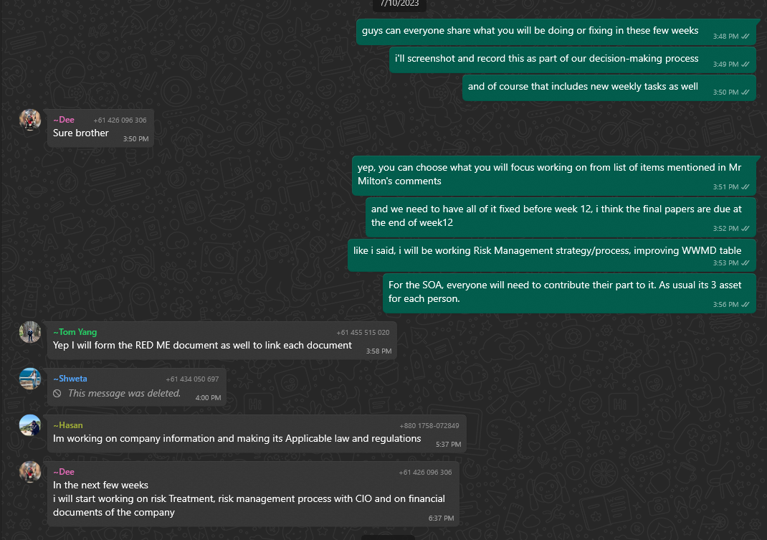
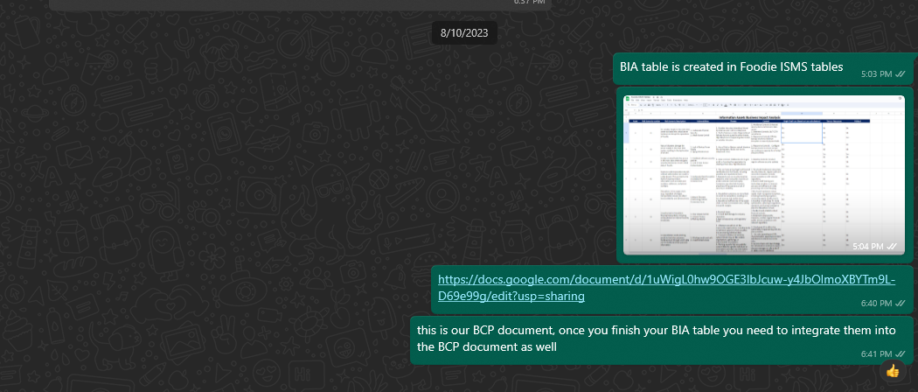
Action items | Owner(s) | Deadline | Status
Identify and fix gaps in the existing ISMS | All members | 27/10/2023 | In progress
Finalize Loss Calculations using Open Fair risk analytics tool | All members | 07/10/2023 | In progress
Conduct BIA | All members | 08/10/2023 | To do
Create BCP document | All members | 08/10/2023 | To do

Slide 80
Once Foodie received its internal audits and identified the relevant non conformities, we started to Improve the identified nonconformities through corrective actions and utilizing the Deming Cycle (Plan-Do-Check-Act).
Plan
Documentation & Record Keeping
Develop more sophisticated templates for meeting minutes to ensure they capture all necessary details.
Update the Company Information document to include compliance requirements and applicable laws and regulations.
Clearly define the purpose and format for documenting evidence of nonconformities and corrective actions.
Create an organized document (see “Readme document”) where all documents are linked and easily accessible.
Start building missing documentation, including TRA, SoA, and Risk Management strategy.

Slide 81
Strategy & Policy
Implementation & Operational
Revise the Risk Treatment Plan to be an actionable list of risks.
Review all existing ISMS operational documents and align them with ISMS objectives.
Develop a comprehensive risk management strategy that defines the risk assessment and risk treatment processes.
Assess the current state of the ISMS and identify gaps.
Develop an ISMS implementation roadmap that is aligned with the identified corrective actions.

Slide 82
DO
CHECK
Monitor and review the changes.
Conduct internal audits to verify the effectiveness of the corrective actions.
Analyze feedback from the internal auditor to ensure that the implemented changes are practical and effective.
Implement the defined strategies and policies in the planning phase.
Set up periodic reviews of the implemented changes to ensure they are working as intended.
ACT
Based on the reviews, make any necessary adjustments to improve.
Document lessons learned and continue to refine the processes as necessary.

Slide 83
THANKING YOU !!

